Slide 1

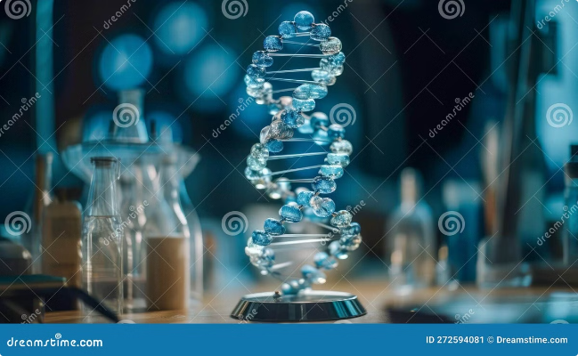
AI-Driven Genetic Risk Prediction: Personalized Healthcare Through DNA Analysis
Predictive genomics is transforming healthcare. By analyzing an individual's DNA, AI algorithms can identify genetic variations associated with disease risks. This data empowers patients to make informed decisions about their health, fostering a proactive approach to healthcare. Made by: Team Mavericks

Slide 2


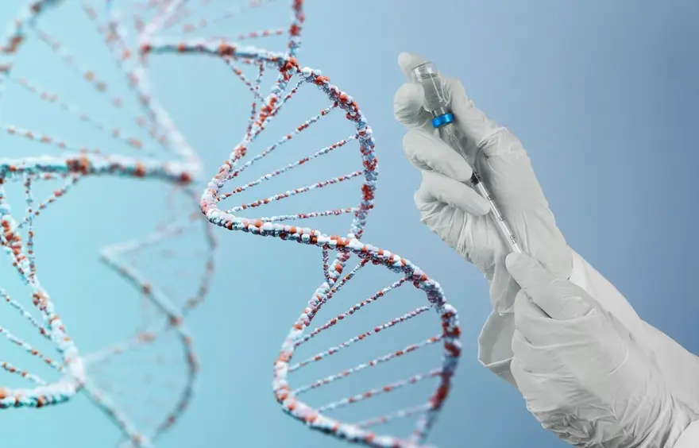
Problem Statement
Early detection and prevention of diseases are crucial for better health outcomes.
Current healthcare systems struggle to provide personalized risk assessments based on genetic information.
This lack of personalized assessment leads to missed opportunities to prevent diseases like cancer, heart diseases and neurological diseases such as Alzheimer’s, Huntington’s etc.
Our solution uses generative AI to analyse DNA data and predict the percentage risk of various diseases.
This approach enables personalized early detection of potentially life-threatening diseases and enables prevention leading to a better lifestyle.

Slide 3
Solution
User DNA Input: Users upload their DNA data into the system.
Personalized Insights: Along with the risk percentages, users receive personalized genetic information.
Risk Assessment: The AI assesses the likelihood of the user developing various neurological diseases.
Percentage Risk Calculation: The model calculates and expresses this risk as a percentage, providing a clear understanding of the user’s potential health challenges.
Results Presentation: The system presents the risk percentages in an easy-to-read format, showing how likely the user is to develop specific neurological conditions.
Personalized Insights: Along with the risk percentages, users receive personalized recommendations for monitoring or reducing their risk, such as lifestyle changes or further medical evaluations.

Slide 4
Tech Stack
Programming Languages: Python
Machine Learning Frameworks: TensorFlow, PyTorch
Genomic Data Processing: Biopython
Data Storage: PostgreSQL, AWS S3
AI Models: Generative Adversarial Networks (GANs), Deep Neural Networks (DNNs)
APIs: RESTful API for integration with healthcare systems
Front-end: React.js for user interface
Security: OAuth 2.0 for authentication, AES encryption for data privacy

Slide 5


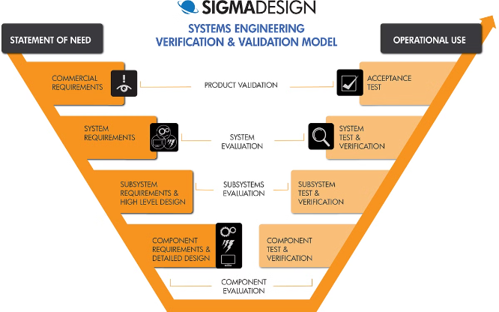



System Architecture/Diagram Workflow
DNA Collection
Individuals provide a biological sample, such as saliva or blood, for DNA extraction.
Genomic Sequencing
DNA is sequenced using next-generation sequencing technology to generate a complete genomic profile.
Data Processing & Analysis
Machine learning algorithms analyze the genomic data to identify disease-associated genetic variants and predict individual risk.
Personalized Report Generation
A comprehensive report is generated, highlighting individual genetic risks, personalized recommendations, and potential preventive measures.

Slide 6
Implementation and Execution Plan
Pilot Study
1
Conduct a pilot study with a small cohort of participants to validate the model's accuracy and feasibility.
2
Data Collection & Annotation
Collect and annotate a large dataset of genomic data and associated health outcomes to train the AI model.
Model Development & Training
3
Develop and train machine learning models using the collected data to predict genetic risks for various diseases.
4
Clinical Validation
Validate the model's performance in a clinical setting, ensuring its accuracy and reliability in predicting disease risk.
Integration with Healthcare Systems
5
Integrate the AI-driven risk prediction platform into existing healthcare systems to seamlessly provide personalized insights to patients.

Slide 7






Role of AI in Your Work
Data Analysis & Pattern Recognition
Risk Prediction & Prognosis
Personalized Recommendations
Healthcare Optimization
AI insights enable healthcare professionals to personalize treatment plans, optimize resource allocation, and improve overall healthcare outcomes.
AI algorithms analyze vast genomic datasets to identify patterns and associations between genetic variations and disease risks.
Based on individual genetic profiles, AI models predict the probability of developing specific diseases and provide personalized risk assessments.
AI-powered systems generate tailored recommendations for preventive measures, lifestyle modifications, and early intervention strategies.

Slide 8


Relevance to SDGs and Benefit to Society
SDG 3: Good Health and Well-being
AI-driven genetic risk prediction enables early disease detection, personalized interventions, and proactive healthcare, contributing to improved health outcomes.
SDG 10: Reduced Inequalities
By providing equitable access to personalized genetic insights, AI helps bridge healthcare disparities and promotes health equity.
SDG 9: Industry, Innovation, and Infrastructure
AI-powered genomics fosters innovation in healthcare, driving technological advancements and economic growth in the life sciences sector.

Slide 9

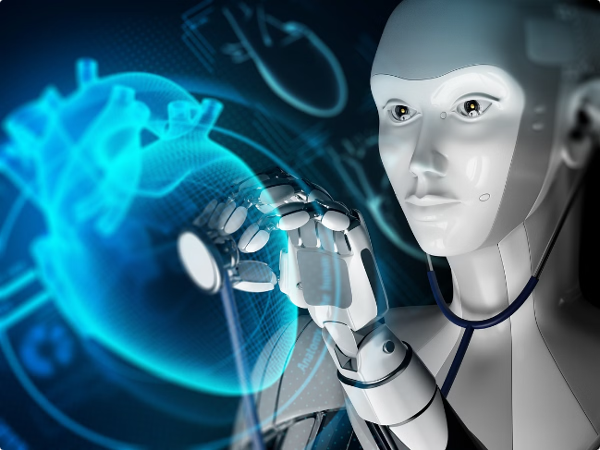
Future Improvements and Scalability
Expansion of Disease Coverage
Personalized Medicine Development
Enhance the AI model to cover a wider range of diseases, including those with emerging genetic research.
AI-driven insights can inform the development of targeted therapies and personalized treatments tailored to individual genetic profiles.
Integration with Wearable Devices
Incorporate real-time health data from wearables to refine predictions and provide dynamic risk assessments.

Slide 10


Conclusion and Key Takeaways
AI-driven genetic risk prediction holds immense potential for revolutionizing healthcare. By providing personalized insights into individual health risks, AI empowers patients and healthcare professionals to make informed decisions, leading to proactive healthcare approaches, improved outcomes, and a healthier society.

